Slide 1

OBJECT ORIENTED MODELLING & DESIGN (OOMD)
SOFTWARE TESTING
UE19CS400SB
Prof. Venkatesh Prasad/Ms.Sumy Joseph
venkateshprasad@pes.edu
Department of Computer Science & Engineering

Slide 2
Classification of Testing types based on methods/ Requirements/target/needs
Contents

Slide 3
Why Testing Important?
Software testing is the process of evaluating and verifying that a software product or application does what it is supposed to do.
The benefits of testing include preventing bugs, reducing development costs and improving performance.
The testing is important since it discovers defects/bugs before the delivery to the client, which guarantees the quality of the software.
It makes the software more reliable and easy to use.
Thoroughly tested software ensures reliable and high-performance software operation.

Slide 4
Testing
Testing in Software Engineering
As per ANSI/IEEE 1059, Testing in Software Engineering is a process of evaluating a software product to find whether the current software product meets the required conditions or not.
The testing process involves evaluating the features of the software product for requirements in terms of any missing requirements, bugs or errors, security, reliability and performance.
Types of Software Testing
Functional Testing
Non-Functional Testing or Performance Testing
Maintenance (Regression and Maintenance)

Slide 5
STLC-SOFTWARE TEST LIFE CYCLE
What is Software Testing Life Cycle (STLC)?
Software Testing Life Cycle (STLC) is a process used to test software and ensure that quality standards are met.
Tests are carried out systematically over several phases.
Software Testing Life Cycle (STLC) is a sequence of specific activities conducted during the testing process to ensure software quality goals are met.
STLC involves both verification and validation activities.

Slide 6
STLC Phases
There are following six major phases in every Software Testing Life Cycle Model (STLC Model):
Requirement Analysis
Test Planning
Test case development
Test Environment setup
Test Execution
Test Cycle closure

Slide 7
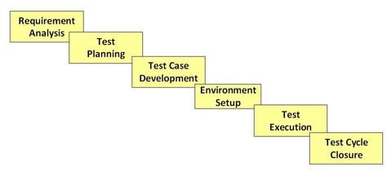
STLC

Slide 8
What is Entry and Exit Criteria in STLC?
Entry Criteria: Entry Criteria gives the prerequisite items that must be completed before testing can begin.
Exit Criteria: Exit Criteria defines the items that must be completed before testing can be concluded

Slide 9
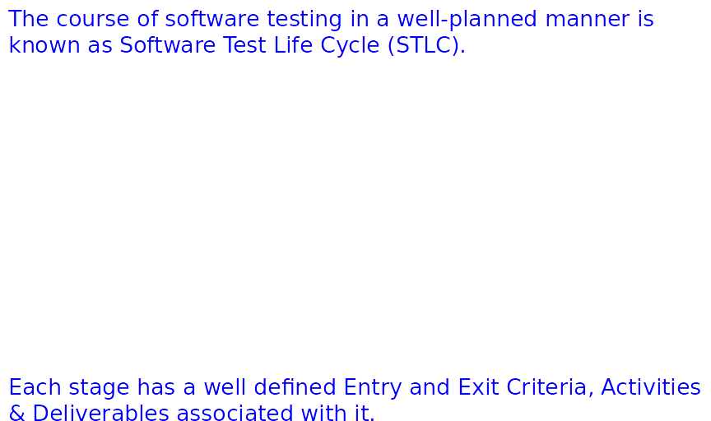
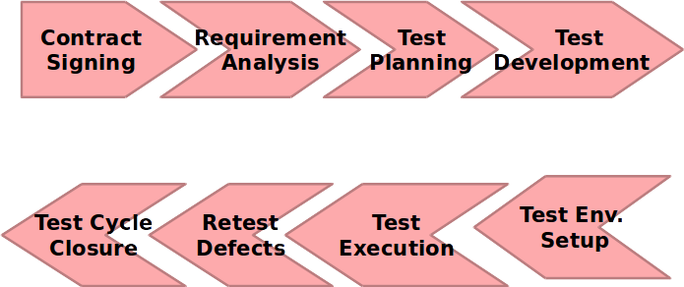
Software Test Life Cycle

Slide 10
STLC PHASES
1. Requirement Phase Testing
Requirement Phase Testing also known as Requirement Analysis in which test team studies the requirements from a testing point of view to identify testable requirements and the QA team may interact with various stakeholders to understand requirements in detail.
Activities in Requirement Phase Testing
Identify types of tests to be performed.
Gather details about testing priorities and focus.
Prepare Requirement Traceability Matrix (RTM).
Identify test environment details where testing is supposed to be carried out.
Automation feasibility analysis (if required).
Deliverables of Requirement Phase Testing
RTM
Automation feasibility report. (if applicable)

Slide 11
2. TEST PLAN
Test Planning in STLC is a phase in which a Senior QA manager determines the test plan strategy along with efforts and cost estimates for the project.
Moreover, the resources, test environment, test limitations and the testing schedule are also determined.

Slide 12
Test Planning in STLC
Test Planning Activities
Preparation of test plan/strategy document for various types of testing
Test tool selection
Test effort estimation
Resource planning and determining roles and responsibilities.
Training requirement
Deliverables of Test Planning
Test Plan /strategy document. TestPlan.doc

Slide 13
3. Test Case Development Phase
The Test Case Development Phase involves the creation, verification and rework of test cases & test scripts after the test plan is ready.
Test Case Development Activities
Create test cases, automation scripts (if applicable)
Review and baseline test cases and scripts
Create test data (If Test Environment is available)
Deliverables of Test Case Development
Test cases/scripts
Test data

Slide 14
4. Test Environment Setup
Test Environment Setup decides the software and hardware conditions under which a work product is tested.
It is one of the critical aspects of the testing process and can be done in parallel with the Test Case Development Phase.
Test Environment Setup Activities
Understand the required architecture, environment set-up and prepare hardware and software requirement list for the Test Environment.
Setup test Environment and test data
Perform smoke test on the build
Deliverables of Test Environment Setup
Environment ready with test data set up
Smoke Test Results.

Slide 15
5. Test Case Execution Phase
Test Execution Phase is carried out by the testers in which testing of the software build is done based on test plans and test cases prepared.
Test Execution Activities
Execute tests as per plan
Document test results, and log defects for failed cases
Map defects to test cases in RTM
Retest the Defect fixes
Track the defects to closure
Deliverables of Test Execution
Completed RTM with the execution status
Test cases updated with results
Defect reports

Slide 16
6. Test Cycle Closure
Test Cycle Closure phase is completion of test execution which involves several activities like test completion reporting, collection of test completion matrices and test results.
Testing team members meet, discuss and analyze testing artifacts to identify strategies that have to be implemented in future, taking lessons from current test cycle.
Test Cycle Closure Activities
Evaluate cycle completion criteria based on Time, Test coverage, Cost,Software, Critical Business Objectives, Quality
Prepare test metrics based on the above parameters.
Document the learning out of the project
Prepare Test closure report
Test result analysis to find out the defect distribution by type and severity.
Deliverables of Test Cycle Closure
Test Closure report
Test metrics

Slide 17
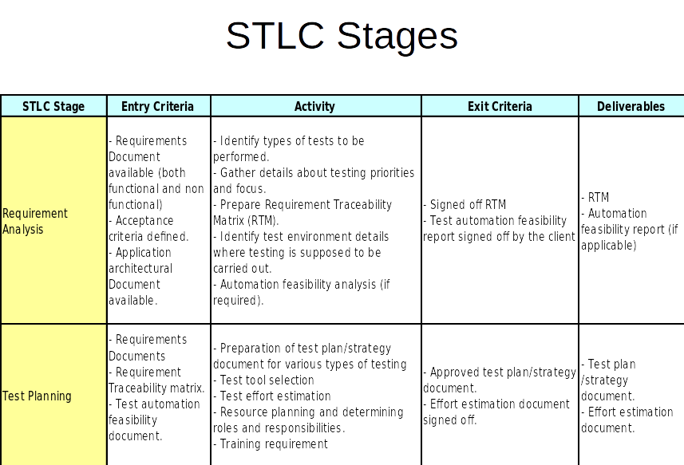

Slide 18
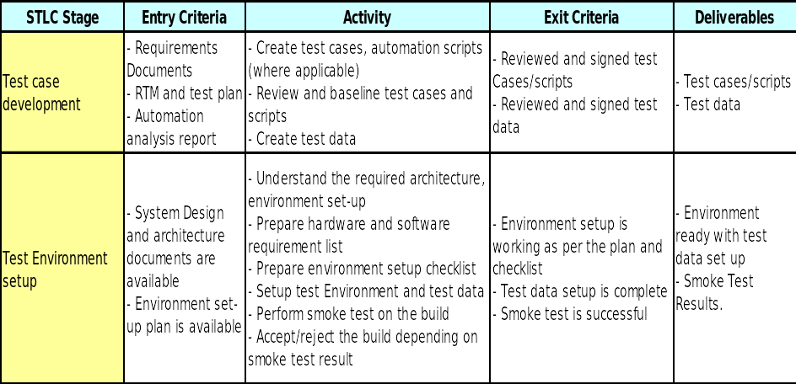

Slide 19
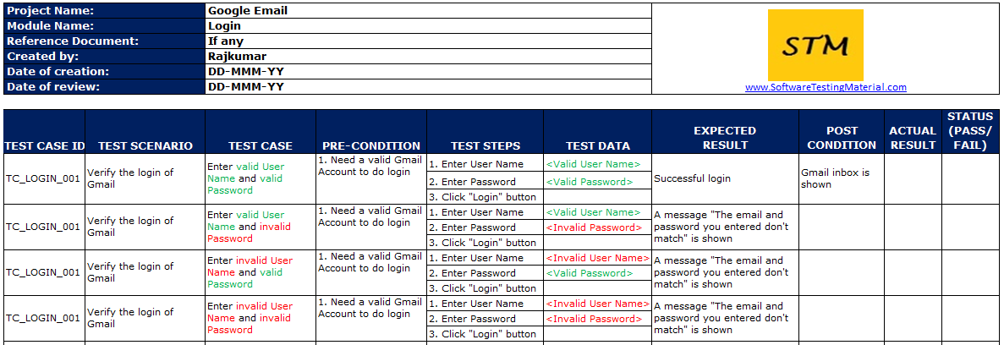
SAMPLE TEST CASE DOCUMENT

Slide 20
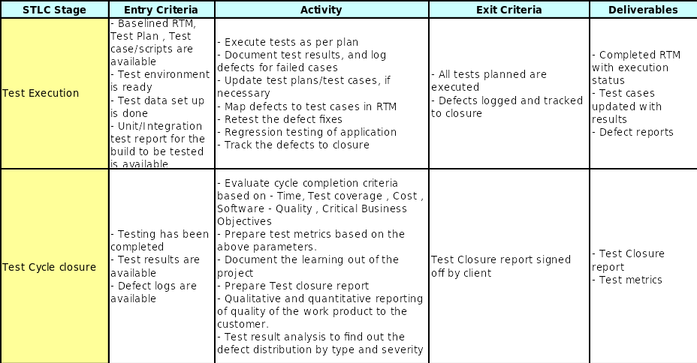

Slide 21
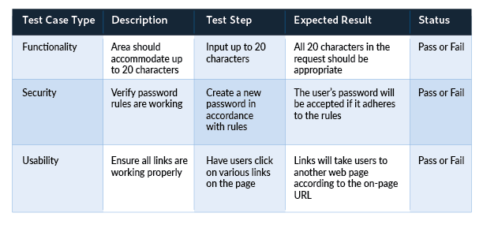
Different Types of Test Cases

Slide 22
Test cases have a few integral parts that should always be present in fields, 8 basic steps.
Step 1: Test Case ID
Test cases should all bear unique IDs to represent them. In most cases, following a convention for this naming ID helps with organization, clarity, and understanding.
Step 2: Test Description
This description should detail what unit, feature, or function is being tested or what is being verified.
Step 3: Assumptions and Pre-Conditions
This entails any conditions to be met before test case execution. One example would be requiring a valid Outlook account for a login.
step 4: Test Data
This relates to the variables and their values in the test case. In the example of an email login, it would be the username and password for the account.
Step 5: Steps to be Executed
These should be easily repeatable steps as executed from the end user’s perspective.

Slide 23
For instance, a test case for logging into an email server might include these steps:
Open email server web page.
Enter username.
Enter password.
Click “Enter” or “Login” button.
Step 6: Expected Result
This indicates the result expected after the test case step execution. Upon entering the right login information, the expected result would be a successful login.
Step 7: Actual Result and Post-Conditions
As compared to the expected result, we can determine the status of the test case. In the case of the email login, the user would either be successfully logged in or not. The post-condition is what happens as a result of the step execution such as being redirected to the email inbox.

Slide 24
Step 8: Pass/Fail
Determining the pass/fail status depends on how the expected result and the actual result compare to each other.

Slide 25
Test Case Import
https://www.youtube.com/watch?v=Lz9JEX_tr-k

Slide 26
SOFTWARE TESTING TYPES

Slide 27
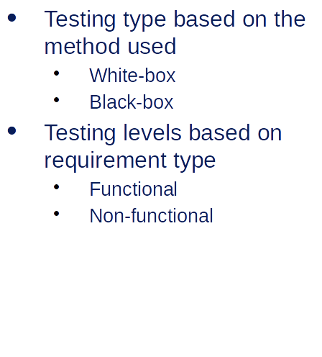
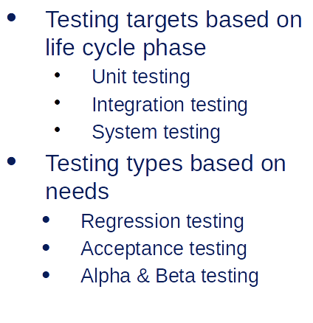
Types of Testing

Slide 28
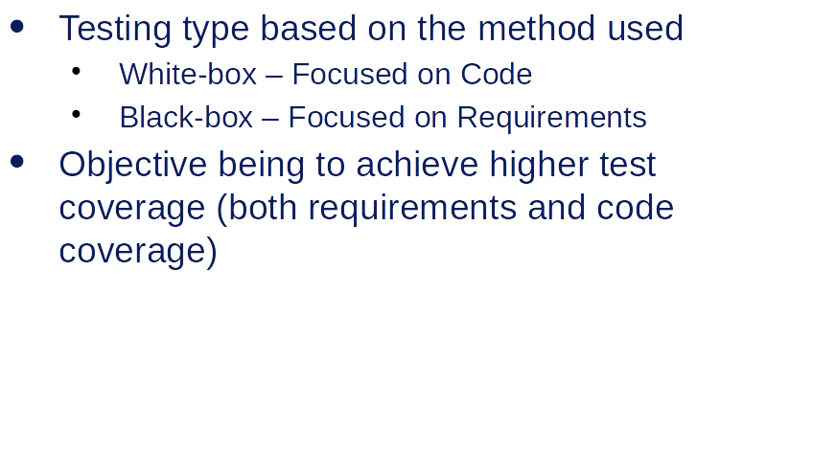
Types of Testing - Based on method used

Slide 29
White Box Testing
White box testing which also known as glass box is testing, structural testing, clear box testing, open box testing and transparent box testing.
It tests internal coding and infrastructure of a software focus on checking of predefined inputs against expected and desired outputs.
It is based on inner workings of an application and revolves around internal structure testing.
In this type of testing programming skills are required to design test cases.
The term 'white box' is used because of the internal perspective of the system. The clear box or white box or transparent box name denote the ability to see through the software's outer shell into its inner workings.
Examples) Path testing,Loop testing, Condition testing

Slide 30
Internal security holes
Broken or poorly structured paths in the coding processes
The flow of specific inputs through the code
Expected output
The functionality of conditional loops
Testing of each statement, object, and function on an individual basis

Slide 31
WhiteBox Testing Example
Printme (int a, int b) { ------------ Printme is a function
int result = a+ b;
If (result> 0)
Print ("Positive", result)
Else
Print ("Negative", result)
} ----------- End of the source code
---------------------------
Parasoft Jtest
EclEmma
NUnit
PyUnit
HTMLUnit
CppUnit

Slide 32
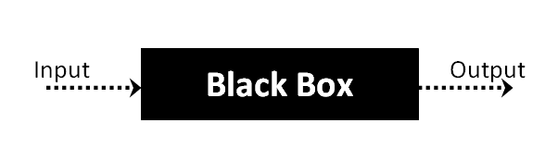
Black Box Testing
Black Box Testing is a software testing method in which the functionalities of software applications are tested without having knowledge of internal code structure, implementation details and internal paths.
Black Box Testing mainly focuses on input and output of software applications and it is entirely based on software requirements and specifications. It is also known as Behavioral Testing.

Slide 33
How to do Blackbox Testing
Here are the generic steps followed to carry out any type of Black Box Testing.
Initially, the requirements and specifications of the system are examined.
Tester chooses valid inputs (positive test scenario) to check whether SUT processes them correctly. Also, some invalid inputs (negative test scenario) are chosen to verify that the SUT is able to detect them.
Tester determines expected outputs for all those inputs.
Software tester constructs test cases with the selected inputs.
The test cases are executed.
Software tester compares the actual outputs with the expected outputs.
Defects if any are fixed and re-tested.

Slide 34
Types of Black Box Testing
Functional testing – This black box testing type is related to the functional requirements of a system; it is done by software testers.
Non-functional testing – This type of black box testing is not related to testing of specific functionality, but non-functional requirements such as performance, scalability, usability.
Regression testing – Regression Testing is done after code fixes, upgrades or any other system maintenance to check the new code has not affected the existing code.
Tools used for Black box testing largely depends on the type of black box testing you are doing.
For Functional/ Regression Tests you can use – QTP, Selenium
For Non-Functional Tests, you can use – LoadRunner, Jmeter

Slide 35
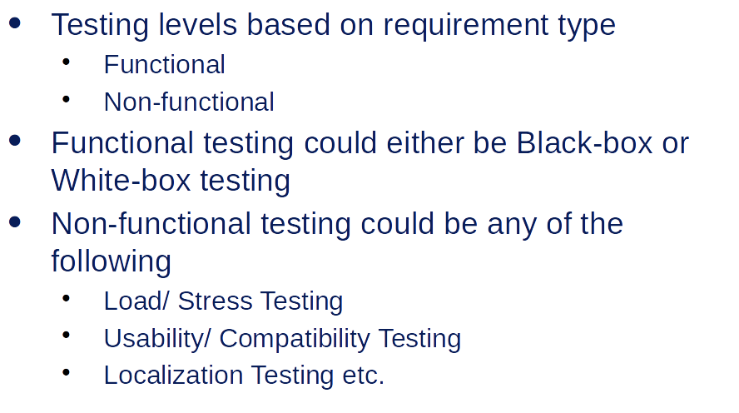
Types of Testing - Based on Requirement type

Slide 36
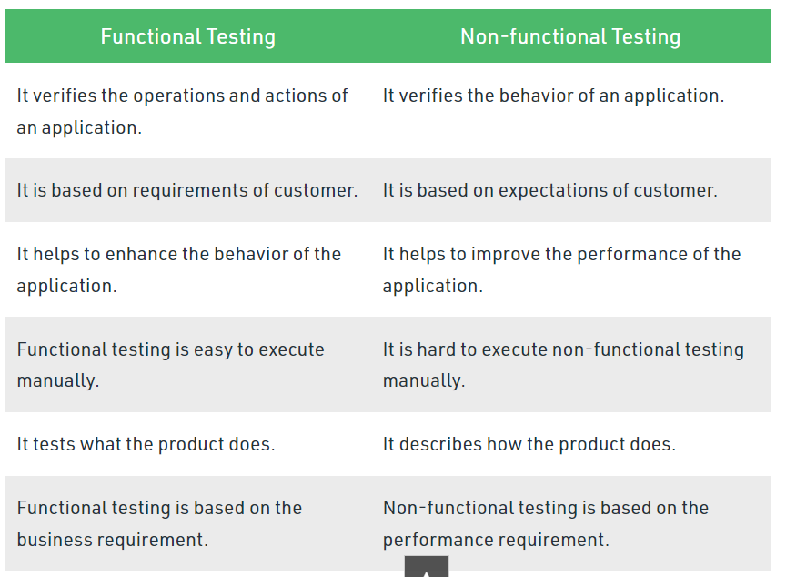
FUNCTIONAL TESTING
Functional testing is a type of software testing in which the system is tested against the functional requirements and specifications
Functional testing ensures that the requirements or specifications are properly satisfied by the application.

Slide 37
NON FUNCTIONAL TESTING
https://www.javatpoint.com/non-functional-testing
Non-functional testing is a type of software testing to test non-functional parameters such as reliability, load test, performance and accountability of the software.
The primary purpose of non-functional testing is to test the reading speed of the software system as per non-functional parameters.
Functional testing checks the correctness of internal functions while Non-Functional testing checks the ability to work in an external environment.

Slide 38
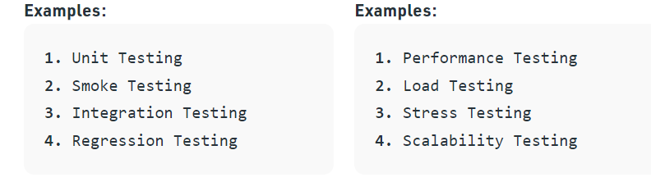
Functional Vs Non Functional

Slide 39
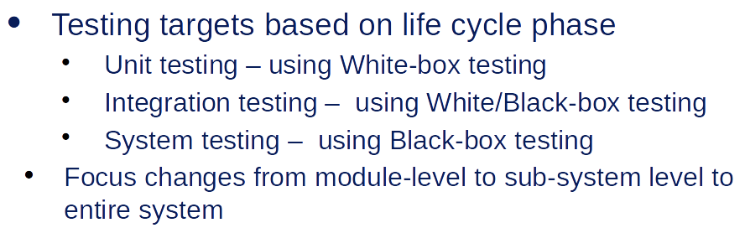
Types of Testing - Based on life cycle phase

Slide 40
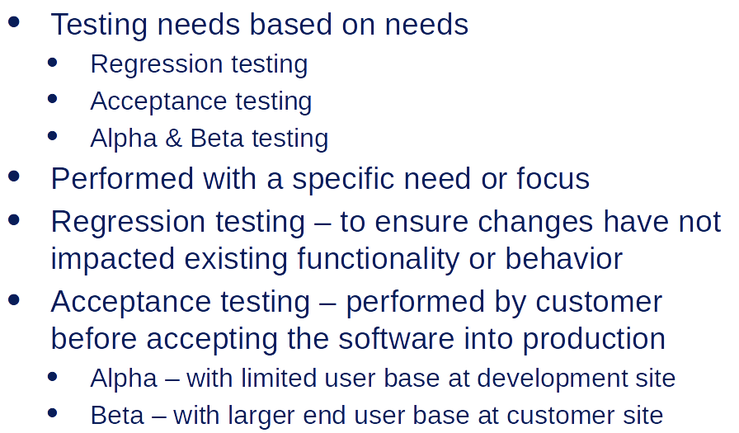
Types of Testing - Based on needs

Slide 41
REGRESSION TESTING https://www.javatpoint.com/regression-testing
Regression testing is re-running functional and non-functional tests to ensure that previously developed and tested software still performs after a change.
This testing is done to make sure that new code changes should not have side effects on the existing functionalities.
It ensures that the old code still works once the latest code changes are done.
When can we perform Regression Testing?
When new functionality added to the application.
2. When there is a Change Requirement.
When the defect fixed
When there is a performance issue fix
When there is an environment change

Slide 42
Regression testing across the release
The regression testing process starts whenever there is a new Release for same project because the new feature may affect the old elements in the previous releases.
To understand the regression testing process, we will follow the below steps:
Step1
There is no regression testing in Release#1 because there is no modification happen in the Release#1 as the release is new itself.
Step2
The concept of Regression testing starts from Release#2 when the customer gives some new requirements.
Step3
After getting the new requirements (modifying features) first, they (the developers and test engineers) will understand the needs before going to the impact analysis.
Step4
After understanding the new requirements, we will perform one round of impact analysis to avoid the major risk, but here the question arises who will do the Impact analysis?

Slide 43
Step5
The impact analysis is done by the customer based on their business knowledge, the developer based on their coding knowledge, and most importantly, it is done by the test engineer because they have the product knowledge.
Step6
Once we are done with the impact area, then the developer will prepare the impact area (document), and the customer will also prepare the impact area document so that we can achieve the maximum coverage of impact analysis.
Step7
After completing the impact analysis, the developer, the customer, and the test engineer will send the Reports# of the impact area documents to the Test Lead.
Step8
Once the Test lead gets the Reports#, he/she will consolidate the reports and stored in the test case requirement repository for the release#1.
Step9
After that, the Test Lead will take the help of RTM and pick the necessary regression test case from the test case repository, and those files will be placed in the Regression Test Suite.

Slide 44
Step10
After that, when the test engineer has done working on the new test cases, the test lead will assign the regression test case to the test engineer.
Step11
When all the regression test cases and the new features are stable and pass, then check the impact area using the test case until it is durable for old features plus the new features, and then it will be handed over to the customer.

Slide 45
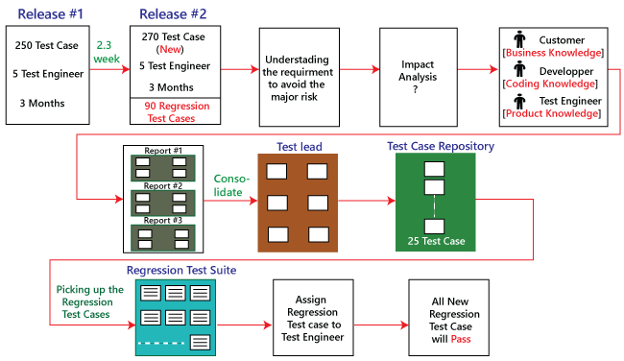

Slide 46
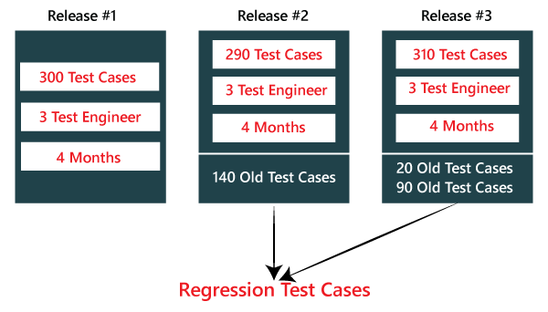

Slide 47
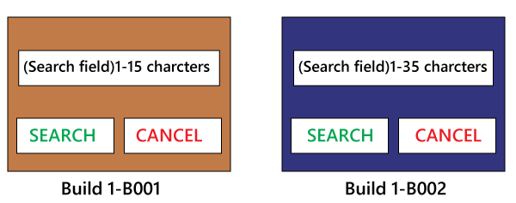
Example1 https://www.javatpoint.com/regression-testing
In the below application, and in the first build, the developer develops the Search button that accepts 1-15 characters. Then the test engineer tests the Search button with the help of the test case design technique.
Now, the client does some modification in the requirement and also requests that the Search button can accept the 1-35 characters.
The test engineer will test only the Search button to verify that it takes 1-35 characters and does not check any further feature of the first build.

Slide 48
ACCEPTANCE TESTING
User acceptance testing (UAT) is a type of testing, which is done by the customer before accepting the final product. Generally, UAT is done by the customer (domain expert) for their and check whether the application is working according to given business scenarios, real-time scenarios.
Watir:
Acceptance testing uses this tool for the execution of automated browser-based test cases. It uses Ruby language for the inter-process communication.
Fitness tool:
This tool is used to enter input values and generate test cases automatically. The user needs to input values, these values used by the tool to execute test cases and to produce output.

Slide 49
ALPHA & BETA TESTING
Alpha testing is conducted in the organization and tested by a representative group of end-users at the developer's side and sometimes by an independent team of testers.
Alpha testing is a type of acceptance testing.
Alpha testing is happening at the stage of the completion of the software product.
Alpha testing is in-house testing, which is performed by the internal developers and testers within the organization.

